Slide 1
Operating system and system programming (25CS2104E)
Kernel Monitor
Review-I
Under the Esteemed Guidance of
Raghupathi M
CSE Department
Team Members:
K.P.S Pranav 252008031
K. Chaitanya Ram 2520090106
B. Vasudeva 2520090136

Slide 2
Contents
Abstract
Introduction
Hardware and Software requirements
System Architecture
Conclusion

Slide 3
Abstract
The Kernel Monitor is a system-level monitoring project designed to observe, analyze, and report the activities and performance of the operating system kernel. The kernel is the core component of an operating system that manages essential resources such as the CPU, memory, processes, files, and input/output devices. Monitoring kernel-level activities is important for understanding system behavior, identifying performance bottlenecks, detecting abnormal activities, and improving overall system reliability. This project focuses on developing a lightweight monitoring mechanism that provides useful information about the internal functioning of the operating system.
The proposed Kernel Monitor collects and displays important system information such as running processes, CPU utilization, memory usage, process states, system calls, and other relevant kernel activities. It provides users with a clear view of how system resources are being utilized and how processes interact with the operating system. The monitor can periodically collect information from kernel interfaces and present it in a structured and understandable format. Process-related information can be used to observe process creation, execution, scheduling, and termination.
Overall, the Kernel Monitor project provides practical exposure to operating system internals, Linux system programming, process management, resource monitoring, and kernel-user space communication. It bridges the gap between theoretical operating system concepts and their practical implementation, making it a useful educational and system-analysis tool.

Slide 4
Introduction
The Kernel Monitor is a system-level monitoring application designed to observe and display important information about the Linux operating system. The Linux kernel manages essential resources such as CPU, memory, processes, and system performance. However, this information is not always easy for users to understand directly.
The proposed Kernel Monitor collects system information from the Linux kernel using interfaces such as the /proc filesystem and Linux system APIs. It monitors details such as CPU usage, memory utilization, running processes, process states, system uptime, and system load.
The project is implemented using C programming on Linux/Ubuntu and demonstrates important Operating System concepts including process management, kernel-user space interaction, system calls, memory management, and resource monitoring. The collected information is processed and presented in a simple and understandable format.
The main purpose of this project is to provide users with a lightweight tool for observing system activity and understanding how the Linux kernel manages computer resources.

Slide 5
Hardware and Software requirements
List the Requirements in table format
Software | Requirement
Operating System | Ubuntu/Linux
Programming Language | C
Compiler | GCC (GNU Compiler Collection)
IDE/Editor | Visual Studio Code / Vim / Nano
Terminal | Linux Terminal
System Interface | /proc filesystem
Libraries | Standard C Library, POSIX/Linux system libraries
Version Control | Git/GitHub (optional)
Hardware | Minimum Requirement
Processor | Intel Core i3 or equivalent
RAM | 4 GB or more
Storage | 20 GB free space
Display | Standard monitor
Keyboard & Mouse | Standard keyboard and mouse
Network | Optional, for software installation and updates

Slide 6
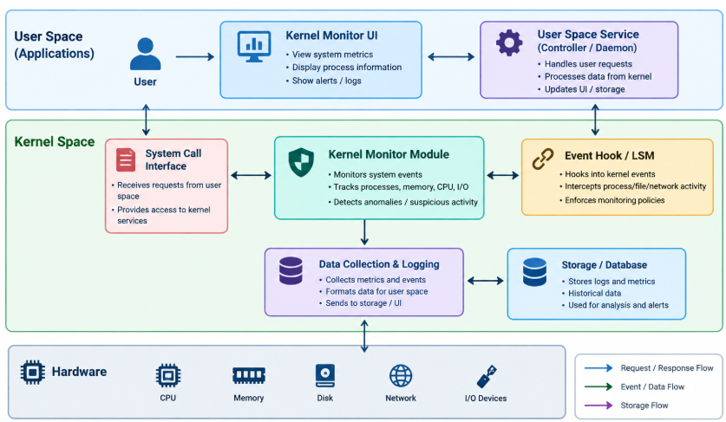
System Architecture

Slide 7
Thank you

